Slide 1


DeFi Survival Analysis: Risks and User Behaviors
Presented at MARBLE 2022: The 3rd International Conference on Mathematical Research for Blockchain Economy (July 2022).
Aaron Green, Chris Cammilleri, John Erickson,
Oshani Seneviratne and Kristin Bennett | July 12, 2022

Slide 2
What’s to Come
Brief DeFi Lending Protocol Introduction
Overview of Survival Analysis for DeFi questions
Explanation of data
Survey of insights gained using Survival Analysis

Slide 3
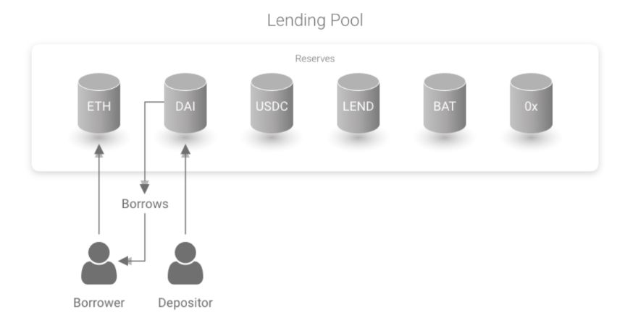
DeFi Lending Protocols
Savings Account:
Deposit various cryptocurrencies into account
Accrue interest on deposited funds
Smart-Contract Lending:
Borrow cryptocurrency supplied by others’ deposits
Use own deposits as collateral, at risk of liquidation
Source: https://github.com/aave/aave-protocol/blob/master/docs/Aave_Protocol_Whitepaper_v1_0.pdf

Slide 4
Survival Analysis For DeFi: An Introduction
Data-driven method for time-to-event analysis
Provides probabilities for occurrences of events through time
E.g. what is the probability that a user repays a loan in the first 100 days after borrowing money?

Slide 5
Survival Analysis For DeFi: An Introduction
Time (days) | Repaid?
78 | Yes
96 | No
52 | Yes
59 | No
39 | Yes
Data-driven method for time-to-event analysis
Provides probabilities for occurrences of events through time
E.g. what is the probability that a user repays a loan in the first 100 days after borrowing money?

Slide 6
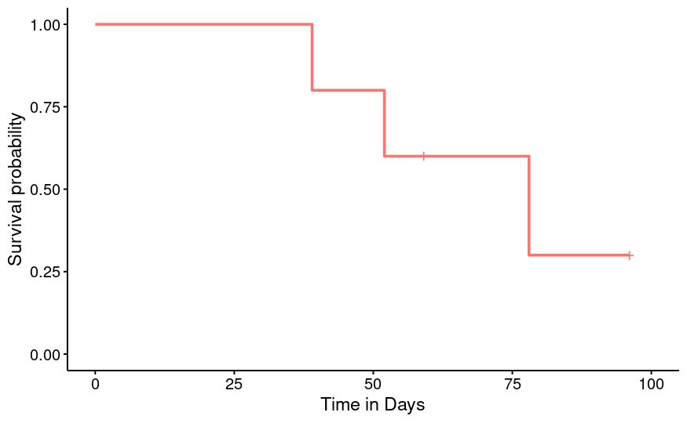
Survival Analysis For DeFi: An Introduction
Time (days) | Repaid?
78 | Yes
96 | No
52 | Yes
59 | No
39 | Yes
Data-driven method for time-to-event analysis
Provides probabilities for occurrences of events through time
E.g. what is the probability that a user repays a loan in the first 100 days after borrowing money?

Slide 7
Survival Analysis For DeFi: An Introduction
Time (days) | Repaid?
78 | Yes
96 | No
52 | Yes
59 | No
39 | Yes
11 | Yes
40 | No
77 | Yes
Data-driven method for time-to-event analysis
Provides probabilities for occurrences of events through time
E.g. what is the probability that a user repays a loan in the first 100 days after borrowing money?

Slide 8
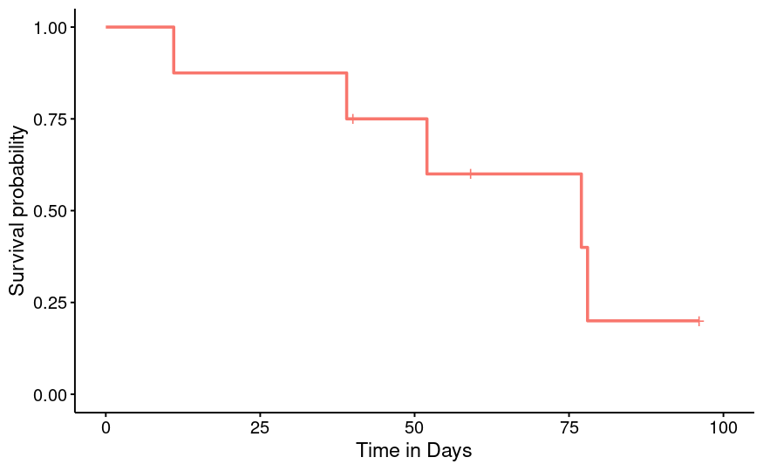
Survival Analysis For DeFi: An Introduction
Time (days) | Repaid?
78 | Yes
96 | No
52 | Yes
59 | No
39 | Yes
11 | Yes
40 | No
77 | Yes
Data-driven method for time-to-event analysis
Provides probabilities for occurrences of events through time
E.g. what is the probability that a user repays a loan in the first 100 days after borrowing money?

Slide 9
Survival Analysis For DeFi: An Introduction
Time (days) | Repaid?
78 | Yes
96 | No
52 | Yes
59 | No
39 | Yes
11 | Yes
40 | No
77 | Yes
Data-driven method for time-to-event analysis
Provides probabilities for occurrences of events through time
E.g. what is the probability that a user repays a loan in the first 100 days after borrowing money?
+ 92 rows (100 total)

Slide 10
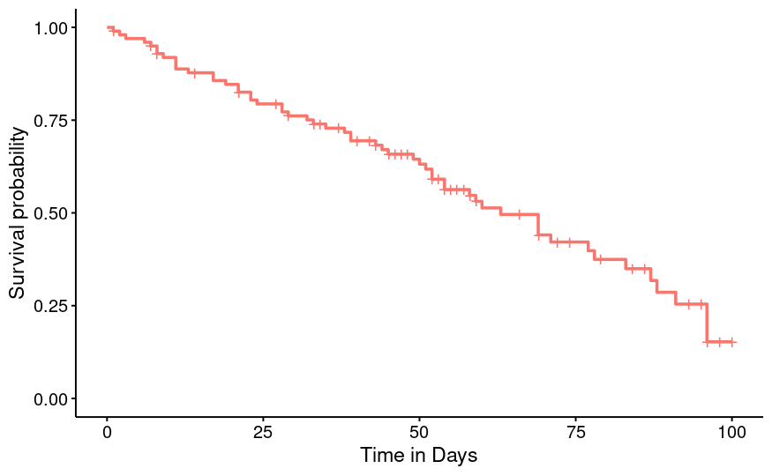
Survival Analysis For DeFi: An Introduction
Time (days) | Repaid?
78 | Yes
96 | No
52 | Yes
59 | No
39 | Yes
11 | Yes
40 | No
77 | Yes
Data-driven method for time-to-event analysis
Provides probabilities for occurrences of events through time
E.g. what is the probability that a user repays a loan in the first 100 days after borrowing money?
+ 92 rows (100 total)

Slide 11
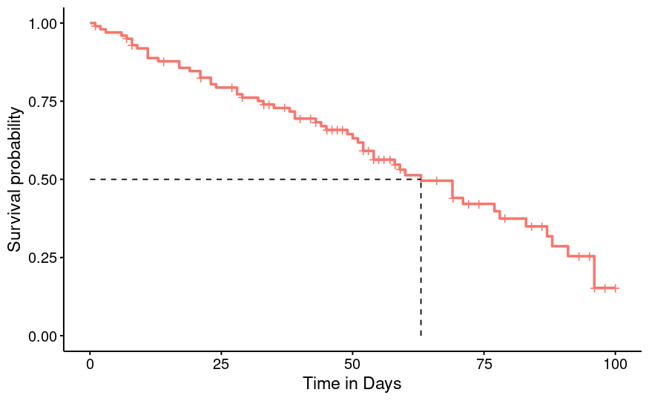
Survival Analysis For DeFi: An Introduction
Time (days) | Repaid?
78 | Yes
96 | No
52 | Yes
59 | No
39 | Yes
11 | Yes
40 | No
77 | Yes
Data-driven method for time-to-event analysis
Provides probabilities for occurrences of events through time
E.g. what is the probability that a user repays a loan in the first 100 days after borrowing money?
+ 92 rows (100 total)

Slide 12
Survival Analysis with Categorical Comparison
Time (days) | Repaid?
78 | Yes
96 | No
52 | Yes
59 | No
39 | Yes
11 | Yes
40 | No
77 | Yes

Slide 13
Survival Analysis with Categorical Comparison
Time (days) | Repaid?
78 | Yes
96 | No
52 | Yes
59 | No
39 | Yes
11 | Yes
40 | No
77 | Yes
Coin Type
Stable
Non-Stable
Non-Stable
Stable
Stable
Stable
Stable
Non-Stable

Slide 14
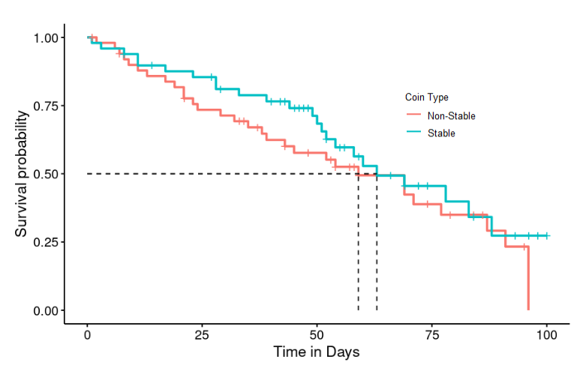
Survival Analysis with Categorical Comparison
Time (days) | Repaid?
78 | Yes
96 | No
52 | Yes
59 | No
39 | Yes
11 | Yes
40 | No
77 | Yes
Coin Type
Stable
Non-Stable
Non-Stable
Stable
Stable
Stable
Stable
Non-Stable

Slide 15

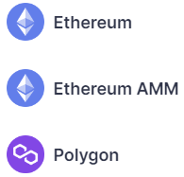
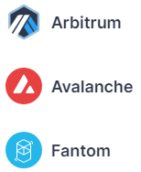

AAVE
One of the largest lending protocols:
First deployed on Ethereum blockchain in November 2020
Now deployed on seven networks, with 13 different markets
~$10 billion USD worth of assets locked across all markets (July 2022)
Over 50 cryptocurrencies allowed for usage on main Ethereum market

Slide 16
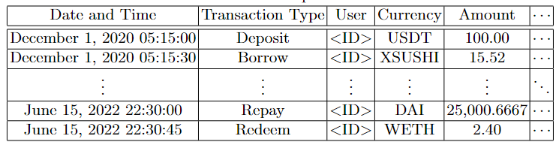
Transaction-Level Data
All 1,198,624 basic transactions since AAVE launched (November 30, 2020 - June 15, 2022)
Data acquired from TheGraph.com, where AAVE developers manage subgraphs for various deployments

Slide 17
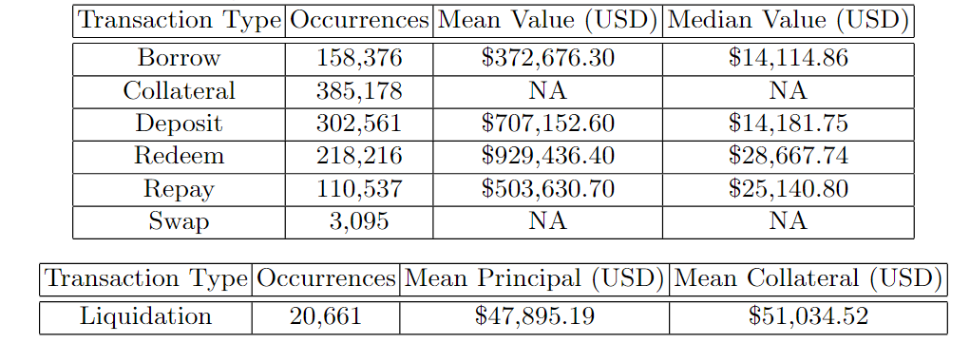
Transaction-Level Data
All 1,198,624 basic transactions since AAVE launched (November 30, 2020 - June 15, 2022)
Data acquired from TheGraph.com, where AAVE developers manage subgraphs for various deployments

Slide 18
Real-Data Example
Each transaction is a candidate for index and outcome events:
E.g., how long do users wait to make a repayment after borrowing funds?

Slide 19
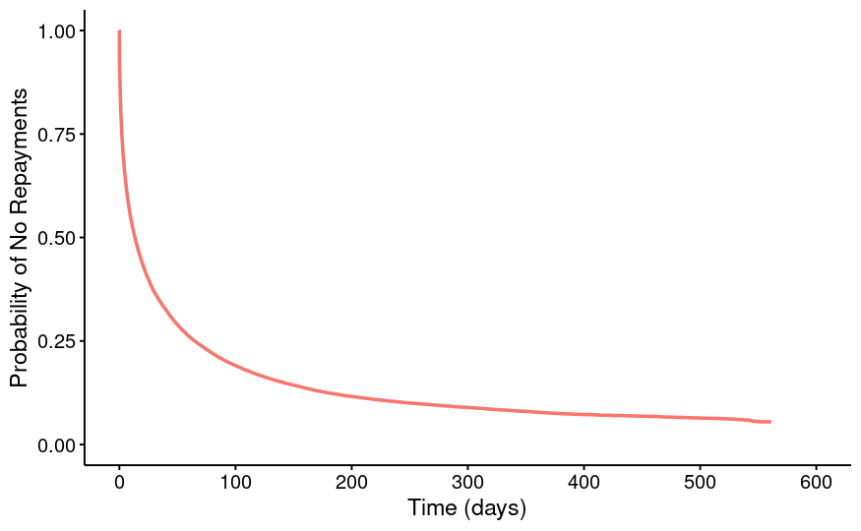
Real-Data Example
Each transaction is a candidate for index and outcome events:
E.g., how long do users wait to make a repayment after borrowing funds?
Index event: borrow transactions
Outcome event: repay transactions

Slide 20
Effect of Coin Type on Loan Outcomes
What are the differences in loan outcome timings (repayments, liquidations) for stable coins versus non-stable coins?

Slide 21
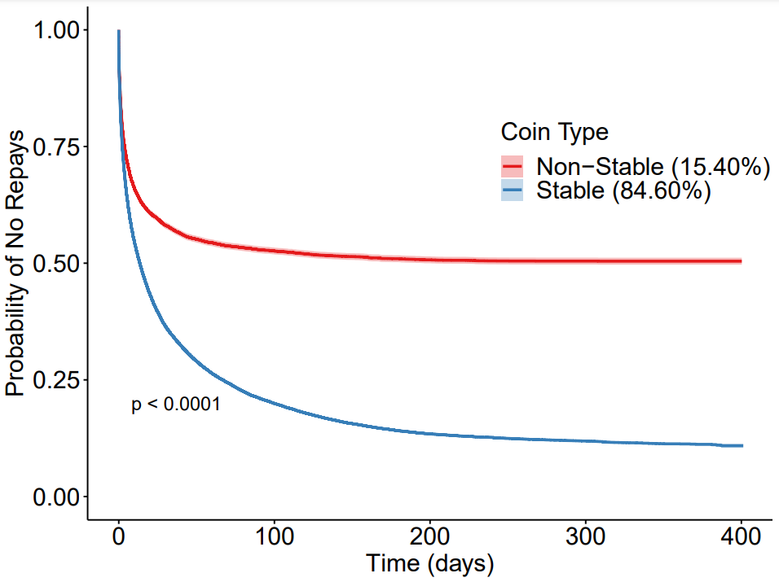
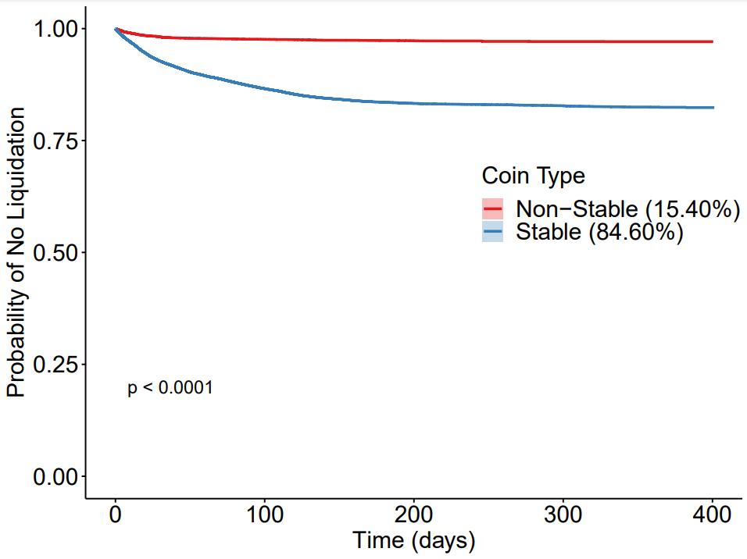
Effect of Coin-type on Loan Outcomes
Outcome event: repayment
Outcome event: liquidation

Slide 22
Principal:Collateral Combinations and Liquidations
More than just single repays can be used as outcomes for borrow events:
Liquidation
Repay in full
Redeem (withdrawal)

Slide 23
Principal:Collateral Combinations and Liquidations
More than just single repays can be used as outcomes for borrow events:
Liquidation
Repay in full
Redeem (withdrawal)
Variety of categories for comparison:
Cryptocurrency borrowed
Type of coin (stable or non-stable)
Amount borrowed

Slide 24
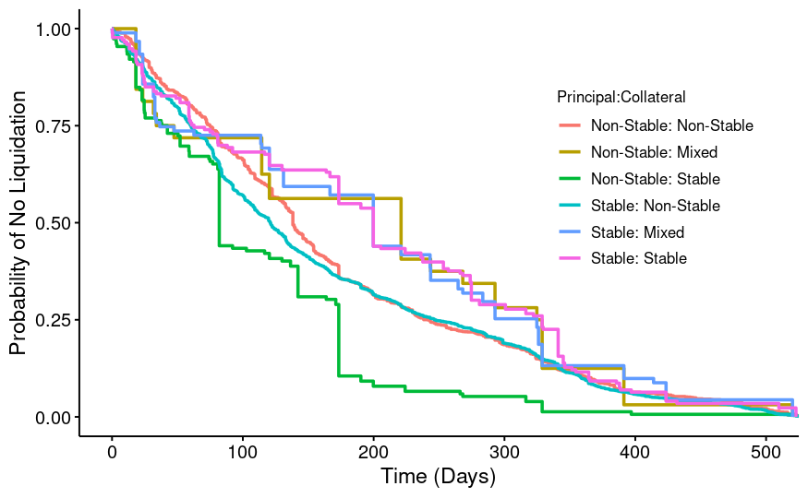
Principal:Collateral Combinations and Liquidations
More than just single repays can be used as outcomes for borrow events:
Liquidation
Repay in full
Redeem (withdrawal)
Outcome event: loan liquidation
Category: Principal-Collateral combination
Variety of categories for comparison:
Cryptocurrency borrowed
Type of coin (stable or non-stable)
Amount borrowed

Slide 25
Understanding Effects of Loan Size
How does loan size affect repayment schedules?

Slide 26
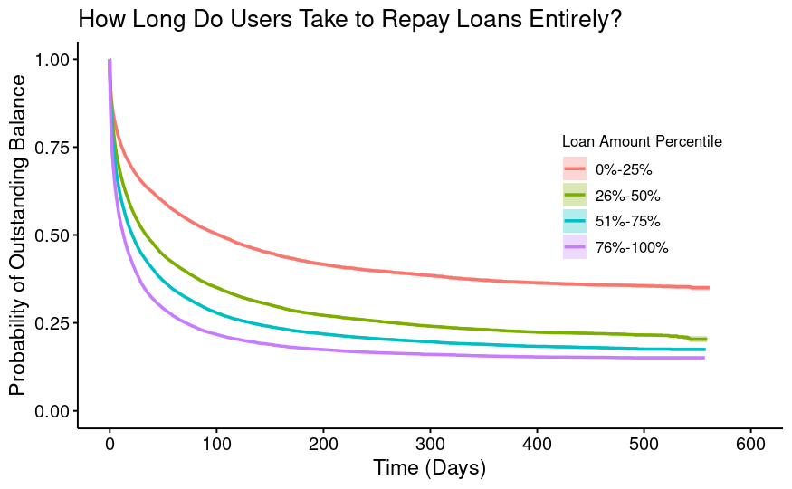
Understanding Effects of Loan Size

Slide 27
Understanding Effects of Loan Size
Larger loans get repaid more quickly!

Slide 28
Understanding Effects of Loan Size
How does riskiness vary with loan size?
Larger loans get repaid more quickly!

Slide 29
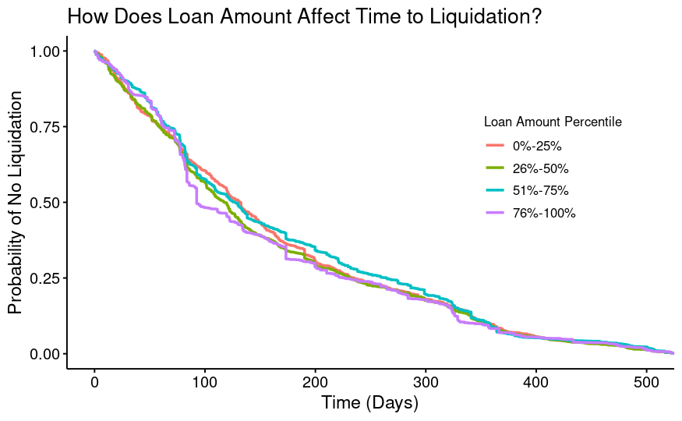
Understanding Effects of Loan Size
Larger loans get repaid more quickly!
Loan size has little to no effect on riskiness!

Slide 30
Changing Time-Windows
Another way to segment survival curves is by time-frame of index or outcome events:
E.g. how have repayment timelines differed between a predominantly bull market (2021) and a predominantly bear market (2022)?

Slide 31
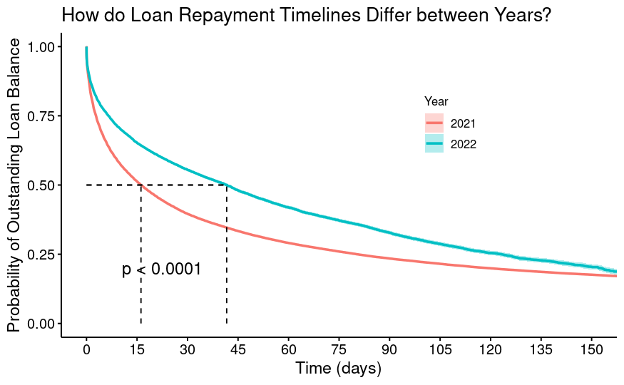
Changing Time-Windows
Another way to segment survival curves is by time-frame of index or outcome events:
E.g. how have repayment timelines differed between a predominantly bull market (2021) and a predominantly bear market (2022)?
Outcome event: full repayment
Category: year borrow was made

Slide 32
Takeaways
Survival Analysis can be applied to transactions in DeFi protocols to yield meaningful insights about user behavior and risk
Myriad options for index/outcome events, categories for comparison
Huge data expansion opportunities to compare findings across DeFi protocols
Open-source R code demonstrating pipeline for conversion from transactional to survival data
Code uses the free survminer library
https://bit.ly/DeFiSurv

